Slide 1
Nanoparticle Aggregation literature review
By: Alan daou, ayo Adebisi, colin breslin

Slide 2
motivation
Develop software that accurately models and visualizes the aggregation of nanoparticles in a system. Will enable us to simulate and predict data for systems we are uncapable of studying experimentally.

Slide 3
introduction
Molecular Dynamics
Monte Carlo Simulation
Lennard Jones Potential
Nearest Neighbors

Slide 4
Molecular dynamics
The Working Person’s Guide to Molecular Dynamics – David Keffer
Molecular Dynamics Simulations of Aqueous NaCl – John P. Brodholt

Slide 5
The Working Person’s Guide to Molecular Dynamics
Intermolecular Potentials
01
Initial Conditions
02
Boundary Conditions
03
Force Evaluation and Neighbours List
04
Algorithm Procedure
05
Scalability
06

Slide 6
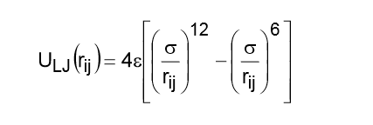
Intermolecular potentials
Intermolecular Interactions Computed
Electron Cloud Repulsion
Attractive van der Waal’s Dispersion
Coulombic Interactions
Intramolecular Forces Computed
Chemical Bond-Stretching
Bond-Bending
Bond-Torsion around a Dihedral Angle
Only considered for molecules with non-negligible internal degrees of freedom
Fluids can be described using pair-wise potentials – Lennard-Jones Potential
Lennard-Jones Pair-Wise Potential Equation

Slide 7

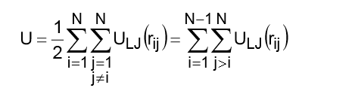
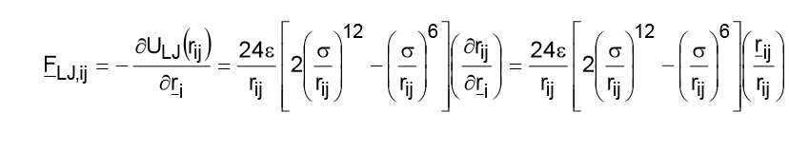
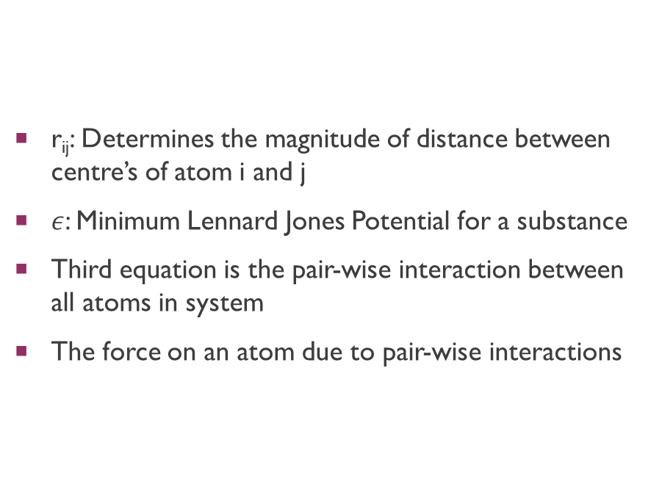
Intermolecular potentials cont.
r_{ij}: Determines the magnitude of distance between centre’s of atom i and j
$ε$: Minimum Lennard Jones Potential for a substance
Third equation is the pair-wise interaction between all atoms in system
The force on an atom due to pair-wise interactions

Slide 8
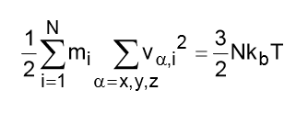
Initial conditions
Perfect Simple Cubic or Face Centered Cubic Initial Configuration
Avoids atoms overlapping at t = 0 and causing repulsion “blow up”
Velocity Stipulations
Translation Momentum is Conserved
Kinetic Energy is related to Thermodynamics Equipartition Theorem
Kinetic Energy Thermodynamics Equipartition Theorem

Slide 9
Boundary conditions
Periodic Boundary Condition
Trajectories of Particles
Every time a particle leaves the simulation space, another enters with the same kinetic energy to maintain conservation of momentum
Minimum Image Conversion
Potential energy of new particle is the same as the old to conserve energy
Applied at the end of each time step

Slide 10
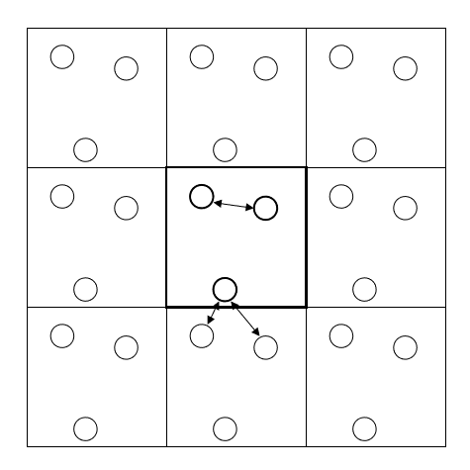
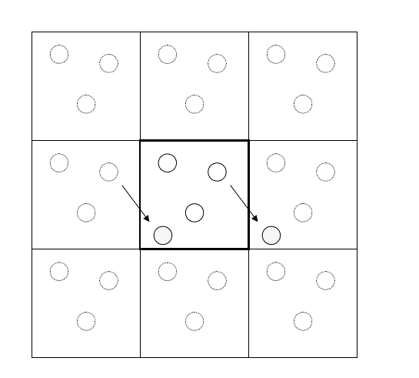
Boundary conditions cont.
Left Image: Displays Minimum Display Convection, nearest neighbor may not be in the simulation space
Right Image: Displays Trajectories of Particles, when one particle leaves the system, another is replaced with the same velocity

Slide 11
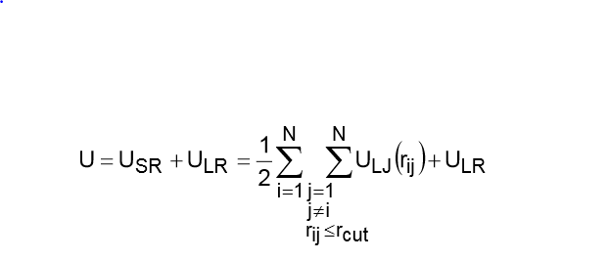
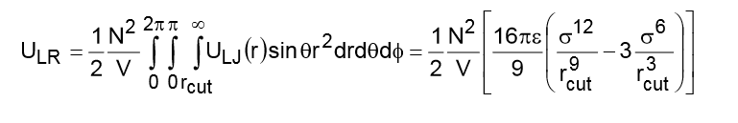
Force evaluation and neighbors list
Sum pair-wise interactions for particles in neighbor’s list
Increases computational efficiency
Interactions less than r_{cut} are calculated explicitly, interactions greater assume mean-field
Long-Range Potential is constant for given N and V values
Assumes isotropic fluid

Slide 12
Algorithm procedure
Initialization
Equilibration
Data Production

Slide 13
initialization
Define
Define System Parameters
Assign
Assign Initial Positions
Assign
Assign Initial Velocities
Generate
Generate Initial Neighbor List
Calculate
Calculate Initial Potential Energy and Forces

Slide 14
EQuilibration
Predict New Positions
Calculate Potential Energy and Forces
Correct New Positions
Apply Periodic Boundary Conditions
Scale Velocities
Update Neighbor List every k_{nbr} steps
Sample Properties every k_{samp} steps
Generate Equilibration Results

Slide 15
Data production
Predict
Predict New Positions
Calculate
Calculate Potential Energy and Forces
Correct
Correct New Positions
Apply
Apply Periodic Boundary Conditions
Update
Update Neighbor List every knbr steps
Sample
Sample Properties every ksamp steps
Save
Save Positions to a file every kmsd steps
Generate
Generate Results of Data Production

Slide 16
scalability
MATLAB is good for a small inputs, Fortran scaled up linearly for large inputs
Production Steps | Equilibrium and Production Steps | Fortran | MATLAB
1000 | 6000 | 15 sec | 4439 sec
10000 | 15000 | 38 sec | 13 hours
50000 | 55000 | 138 sec | Timed Out

Slide 17
Molecular Dynamics Simulations of Aqueous NaCl
Predicts Thermodynamic Properties of NaCl at unknown Conditions

Slide 18
method
Nose-Hoover Constant NPT Ensemble to Control Temperature and Pressure
Equations of Motion solved using Standard Leapfrog Scheme and SHAKE Algorithm
Rotation dealt with Quaternions
Time step 2 fs
Total Simulation time 70 ps

Slide 19
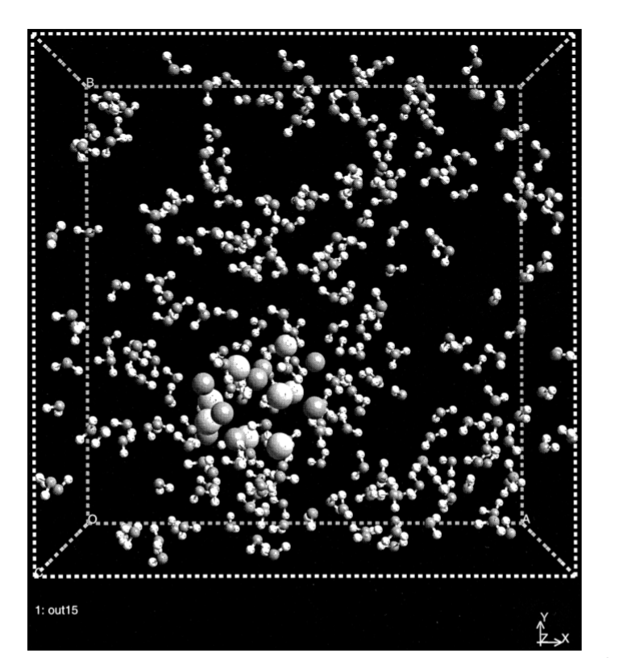
result
NaCl Clustering and Dispersion Predicted
Radial Distribution Agreed with Literature Data

Slide 20
Monte Carlo
Monte Carlo Simulation of Particle Aggregation – Pushkar Tandon
Self-Assembly of the Symmetric Diblock Copolymer – Xuehao He

Slide 21
Monte Carlo Simulation of Particle Aggregation
Model Particle Aggregation caused by Coagulation using Monte Carlo Techniques
Particle Evolution Modeled using Smoluchowski Equation
Apply Equation to determine Sensitivity of Particle Size and Surface Area to Aggregation
Monte Carlo is suited for Multivariate Coagulation Problems

Slide 22
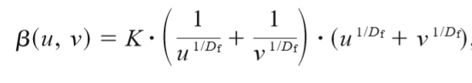
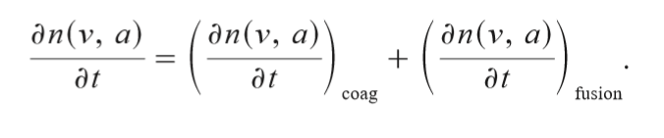

Mathematical models
n is a function of particle volume and surface area
First term on right hand side is Brownian coagulation
$Β:$ Collision Frequency Rate Constant
Monte Carlo methods are suitable for aggregation and fusion problems

Slide 23
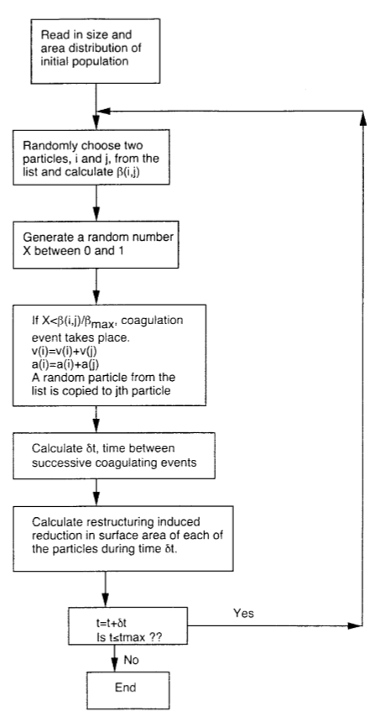
procedure

Slide 24
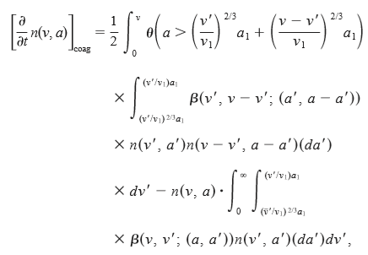
Results and conclusion
Monte Carlo Method is accurate for equations that require are lot of computations
Smoluchowski Equation can be used to model Self-Preserving Systems
Balances between Coagulation and Fusion

Slide 25
Self-Assembly of the Symmetric Diblock Copolymer
Computer Simulations used to simulate the self-assembling behavior of symmetric diblock copolymers in a confined state in which there are interactions between the boundary and diblock copolymers

Slide 26

Model and simulation
Single-Site Bond Fluctuation Model
Eighteen Nearest Neighbour Particles Array
Distance between Single Unit and Nearest Neighbor Site: $1≤L≤\sqrt{2}$

Slide 27
Results and conclusions
Self-Assembly can be controlled with appropriate boundary conditions

Slide 28
Molecular dynamics and monte Carlo hybrid
Hybrid Method Coupling Molecular Dynamics and Monte Carlo Simulations – S.V. Nedea

Slide 29
Hybrid Method Coupling Molecular Dynamics and Monte Carlo Simulations
Model the motion of gas molecules confined between two hard walls of a microchannel or nanochannel
Study One Dimensional Heat Flow between two Parallel Infinite Plates
Hybrid Simulation Utilizing Molecular Dynamics (MD) and Direct Simulation Monte Carlo (DSMC)
MD: Molecules move and collide according to forces they exert on each other
Sufficient for collisions with the wall and boundary, too slow otherwise
DSMC: Molecules move based on stochastically generated coordinates, with velocity distributions described by Kinetic Theory
Speeds up computations for bulk fluid collisions
Hybrid Simulation is ideal for dense systems

Slide 30
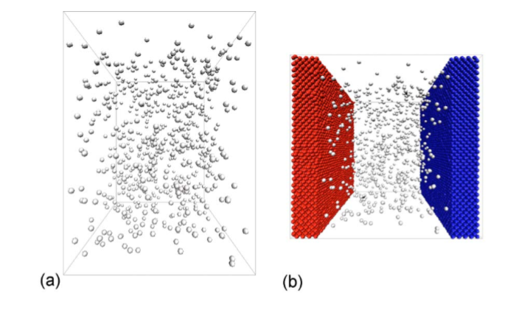
Physical model
a) Shows the model when boundary conditions are used, thermal wall boundary
b) When boundary conditions are ignored and model is solved explicitly

Slide 31
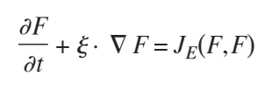


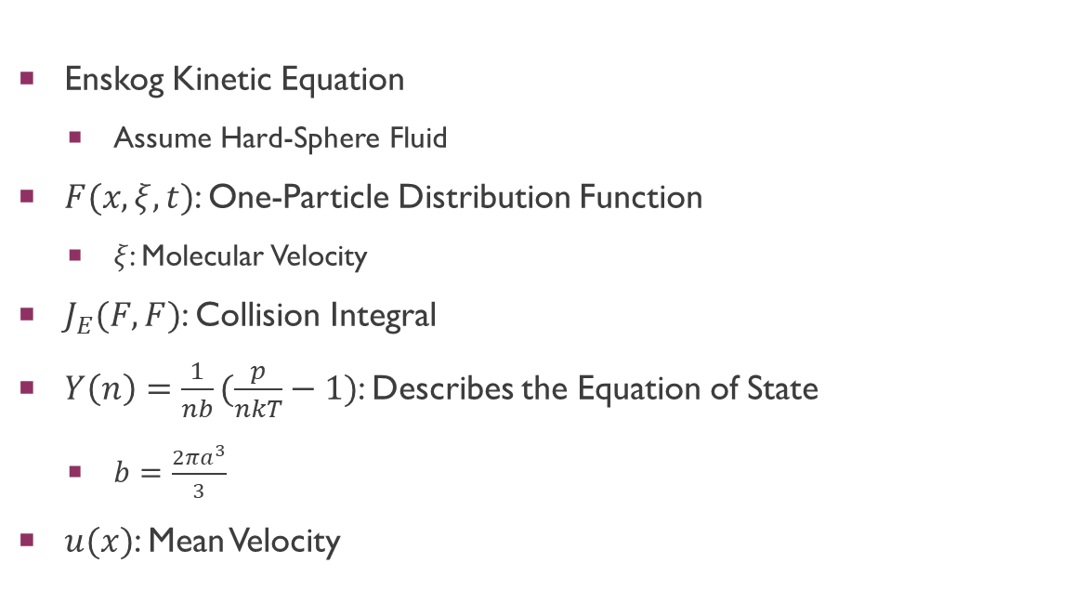
Pure Monte carlo methods
Enskog Kinetic Equation
Assume Hard-Sphere Fluid
$F(x, ξ, t)$: One-Particle Distribution Function
$ξ$: Molecular Velocity
$J_{E}(F, F)$: Collision Integral
$Y\left(n\right)=\frac{1}{nb}(\frac{p}{nkT}−1)$: Describes the Equation of State
$b=\frac{2πa^{3}}{3}$
$u(x)$: Mean Velocity

Slide 32
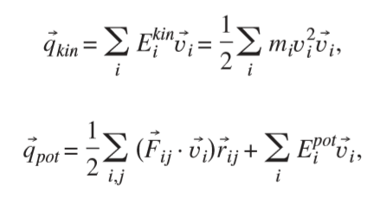
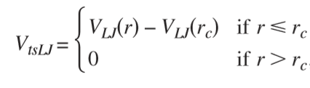
Pure Molecular dynamics
Lennard-Jones Interactions between all Pair of Particles
Constraints on LJ Range is Applied in this Study as well
Used for both explicit model and boundary wall model
Kinetic Energy and Potential Energy can be calculated using MD

Slide 33
Comparison between pure MD an dsmc methods
Particle Size
DSMC: One particle represents several gas molecules as oppose to one
Inaccurate when particle sizes are large
Wall-Interactions
MD: When the interaction strength was increased, particles were attracted to the wall
Very accurate for simulating wall when compared to DSMC
Pure MD Method
Time consuming
MD is sufficient for both bulk and wall interactions

Slide 34
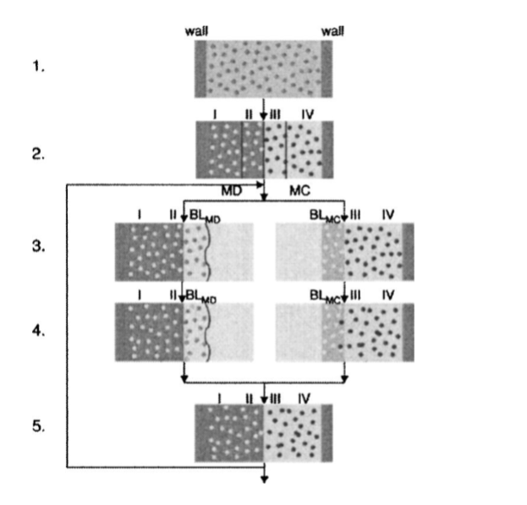
hybrid
1) Randomly Generate Velocities and Positions using Maxwell-Boltzmann Distribution
2) Particles in MD range are sent to MD simulator, and likewise for MC
3) Information of Neighboring particles are needed in both simulations, so extended buffer regions are created. BL_{MD} and BL_{MC}
4) Both simulations can now work in parallel
5) System is then merged

Slide 35
Hybrid system details
Importing neighbor particle data from MC-to-MD is problematic
MC allows particles to overlap, MD does not, this leads to large repulsive forces
Overlapping Particles can be regenerated in new positions; time consuming
Macroscopic properties are copied instead of single particles
Velocity of particles in MD region are scaled to match particles in MC region
Hybrid allows for Parallel Computing and larger particle systems

Slide 36
Conclusion and results
Pure MD-MC Simulations deviated from literature data by 0.9%-1.5%
Hybrid MD-MC Simulations deviated from literature data by 0.32%-0.42%
Accurate for a dilute and dense gas
Simulation is also much faster than a pure MD method

Slide 37
Nearest neighbor computation
A Fast Algorithm for Particle Simulations – L. Greengard

Slide 38

A Fast Algorithm for Particle Simulations
Improvement on pairwise interaction computations from $O(N^{2})$ to $O(N)$
Used to improve the interactions caused by charges
Previous solution with a time complexity of $O(N+M\log{M)}$
N: Number of particles
M: number of mesh points
Solutions
Interpolating the source density at mesh points
Using Fast Poisson Solver
Computing the force from the potential and interpolating to the particle positions
See Paper Page 7-8 for Algorithm and Boundary conditions

Slide 39
Conclusion and Next steps
Diffusion and Mass Transfer Terms
Nearest Neighbors Computation
Incorporating Particle Charge

